Slide 1
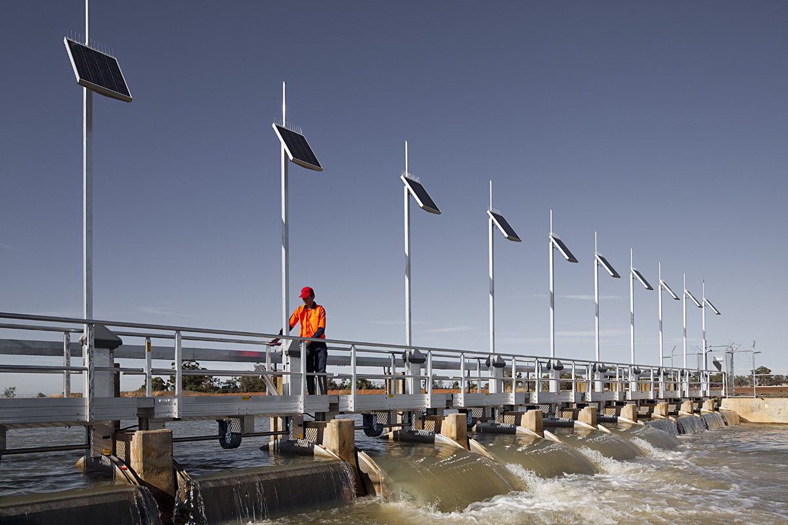
Rubicon Water
Measurement, Monitoring, Control & Mgt. solutions
INTERNATIONAL SEMINAR ON “RELIABLE DATA ACQUISITION SYSTEM FOR INTEGRATED WATER RESOURCES MANAGEMENT”
(7th – 8th November, 2016)
Dr. Ajay Pradhan (Advisor)

Slide 2
Agenda
Non urban metering standards – a snap shot
SlipMeter™
FlumeGate™
BladeMeter™
1
2
3
4
Rubicon Water delivers advanced technology that optimises gravity-fed irrigation, providing unprecedented levels of operational efficiency and control, increasing water availability and improving farmers’ lives
2
Notes:
2

Slide 3

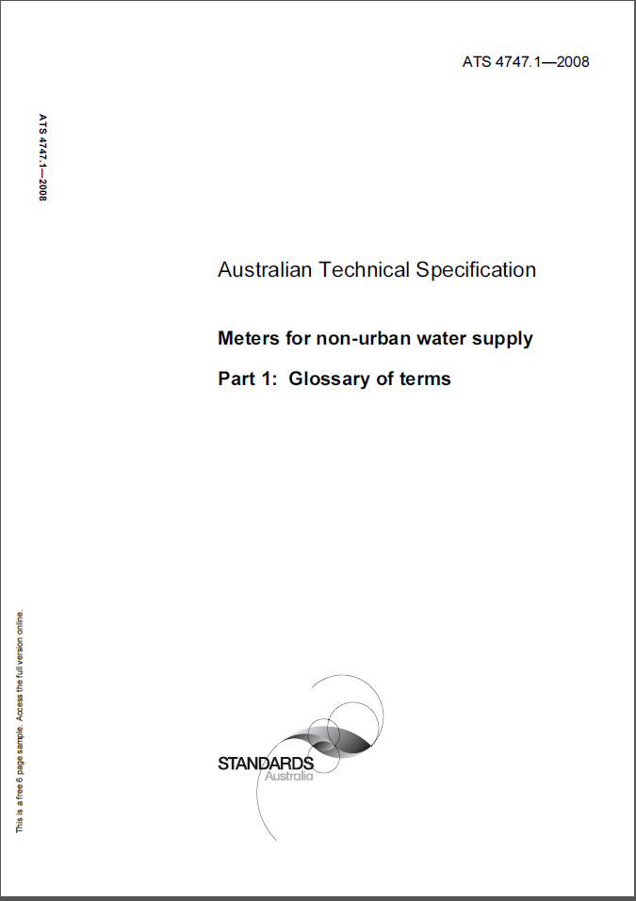
Non urban metering standards – a snapshot
There are only very few non urban metering standards
  Australian Metering Standards ATS 4747
    Very exhaustive and stringent testing requirements
    Stipulates flow accuracy of ±2.5% under standard testing conditions and ±5% in the field
  American (Californian) Standard SBx 7.0 – stipulates the verification of accuracy of annual volumes provided at delivery points. Existing devices ±12% by volume, New devices ±5% by volume.

Slide 4
Rubicon Gates and Meters

Slide 5
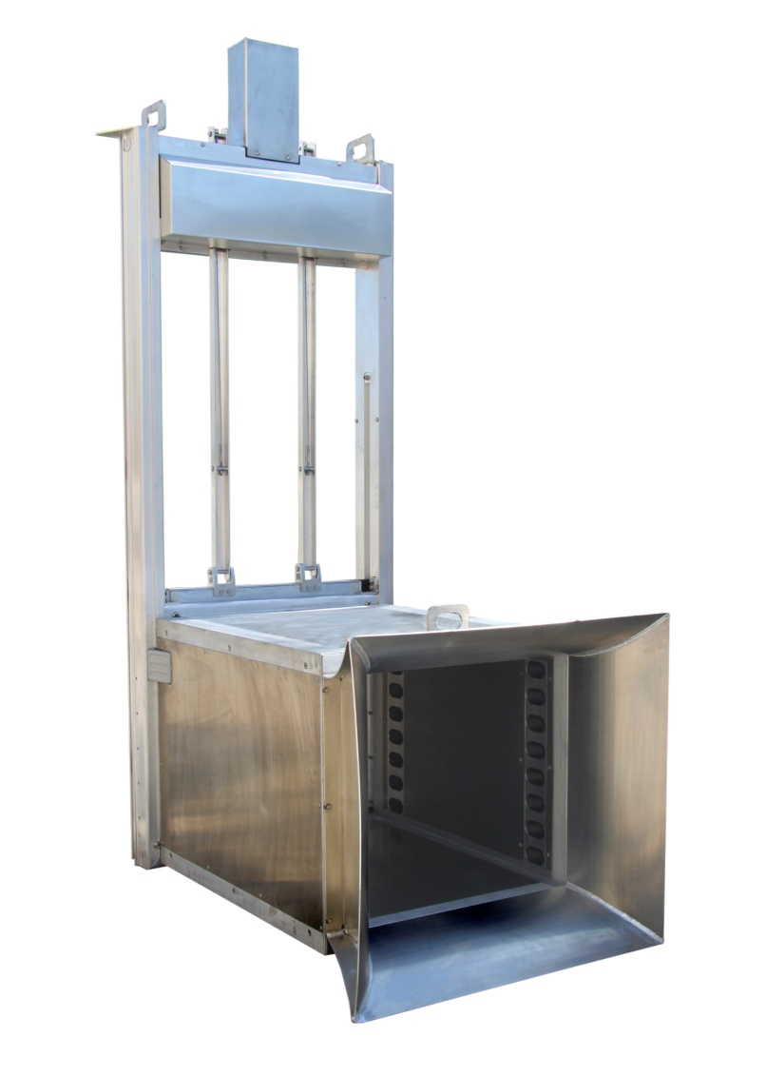
SlipMeter™
Overview
All in one vertical gate and flow meter for farmer service points and Cross regulators
All-in-one means everything – drive system, motor control, ultrasonic measurement (water level and flow), power supply, local control and telemetry
Robust high duty cycle operations and long life
SCADA ready
Autonomous control capability – Flow, USL, DSL and network control with a cascade of gates
Comes separately with the meter component alone - FlumeMeter™
Factory precalibrated and pre-commissioned. No in-situ calibration required
Easily installed and serviced
Comes in variety of standard sizes and custom options
Independently verified flow measurement accuracy of ±2.5% at National Metering Institute Certified Manly Hydraulics Lab
Flow measurement accuracy of ±2.5% has been independently verified under a wide range of conditions in the field in different countries
Meets ATS 4747 requirements
Exceeds SBx7 requirements
Patented/Patent pending across 18 jurisdictions including India

Slide 6
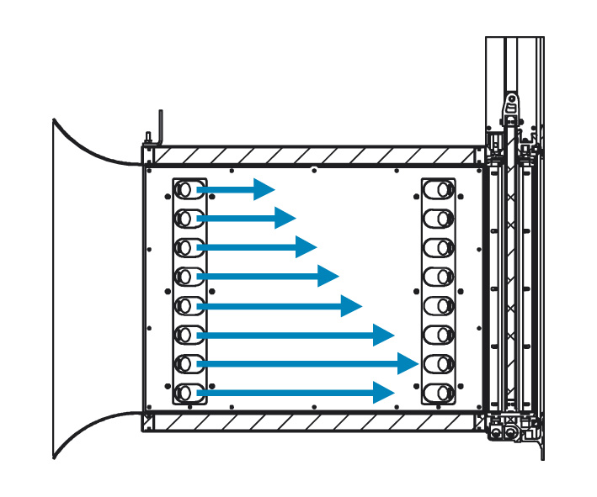
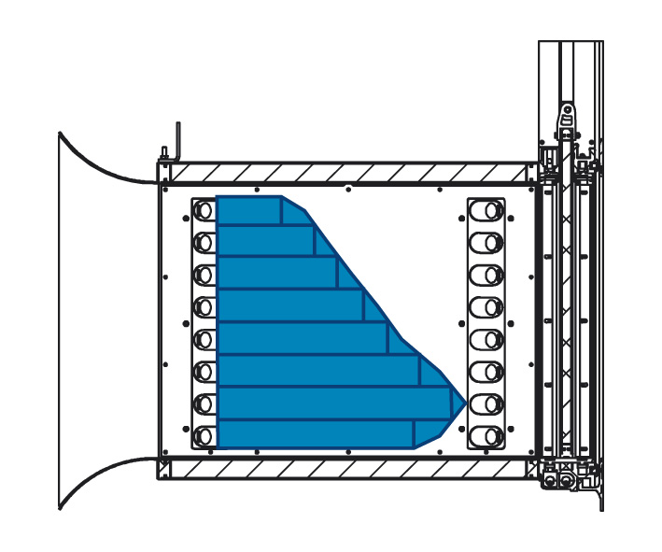
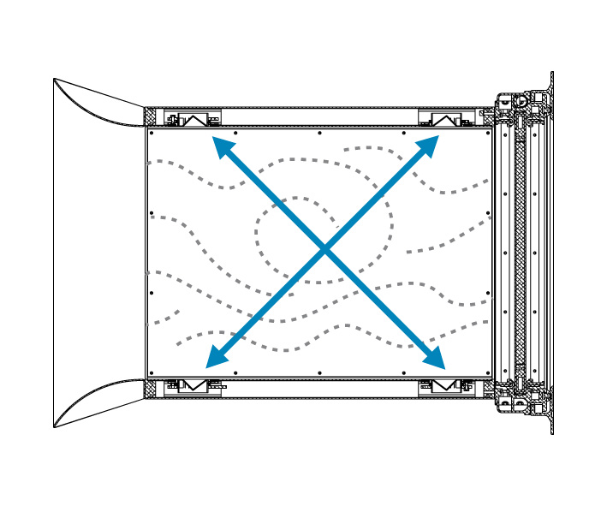
SlipMeter™
Flow metering principle
The velocity profile is measured across all plans then integrated to determine mean flow velocity and then multiplied by cross-sectional area
Transit time unaffected by turbulence
Sampled in each of eight planes
Integrated & multiplied
Refer to ISO 6416

Slide 7

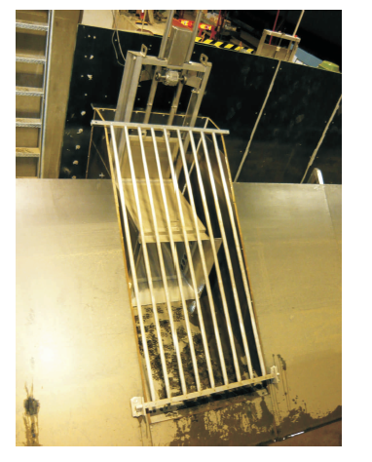
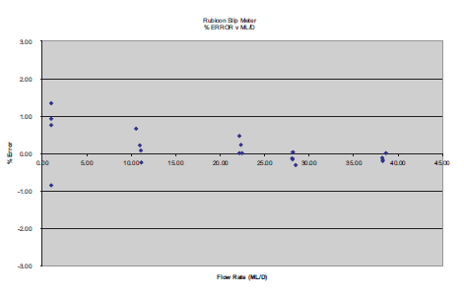
Independently verified at the Manly Hydraulics Laboratory

Slide 8
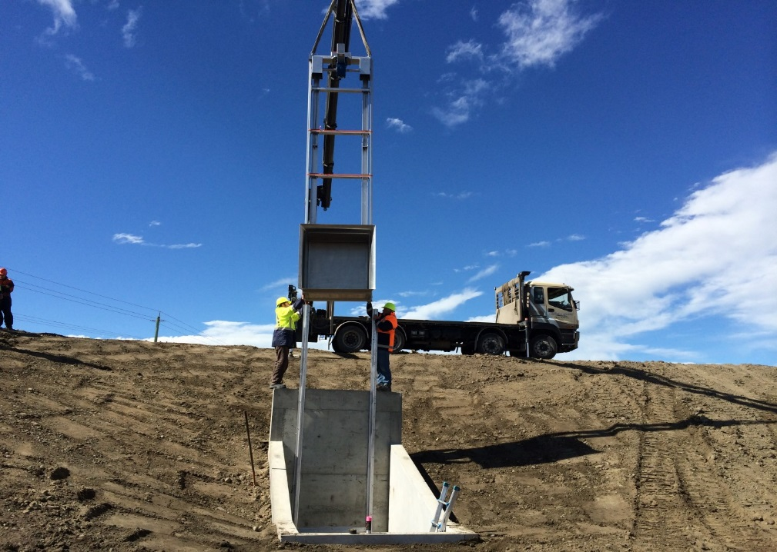
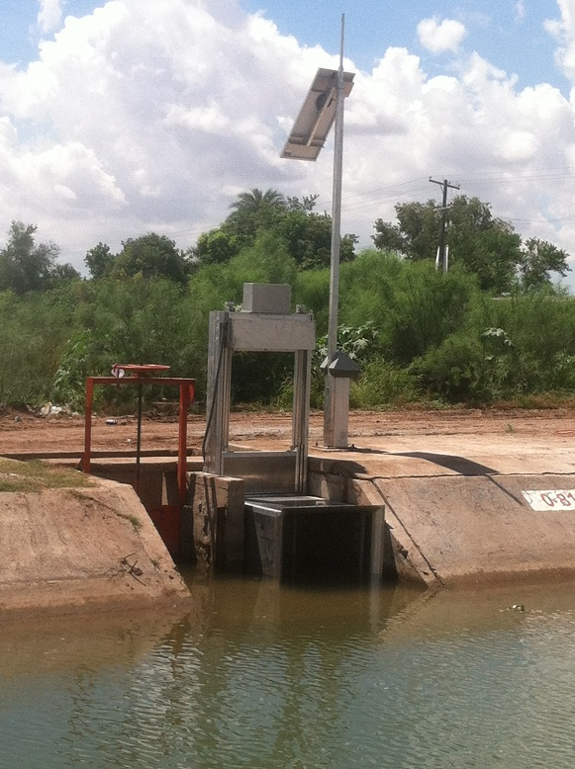
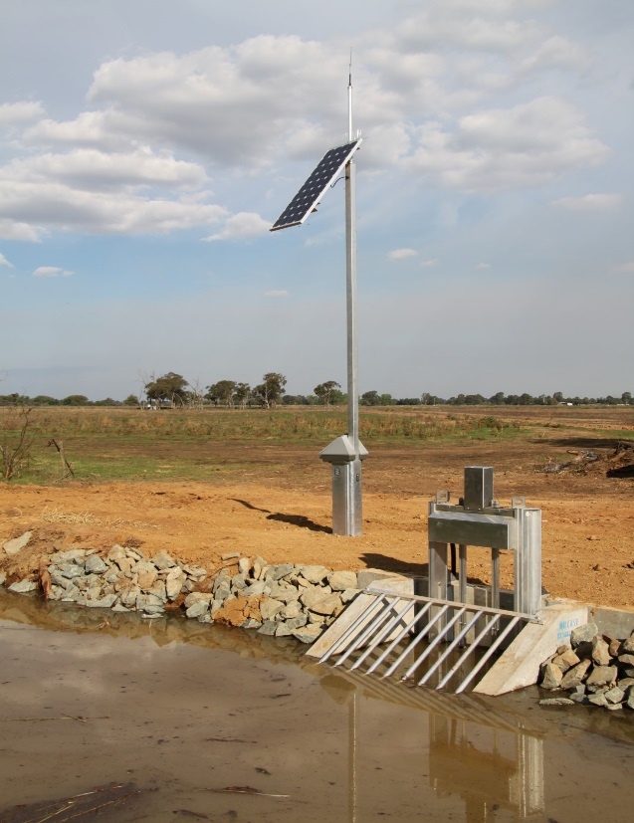
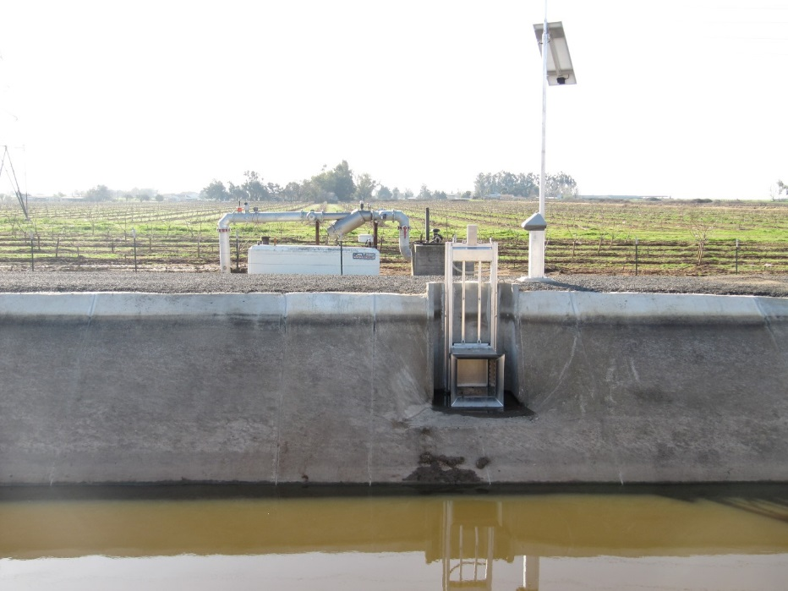
SlipMeter™ - Application examples
NEW ZEALAND
MEXICO
AUSTRALIA
USA

Slide 9
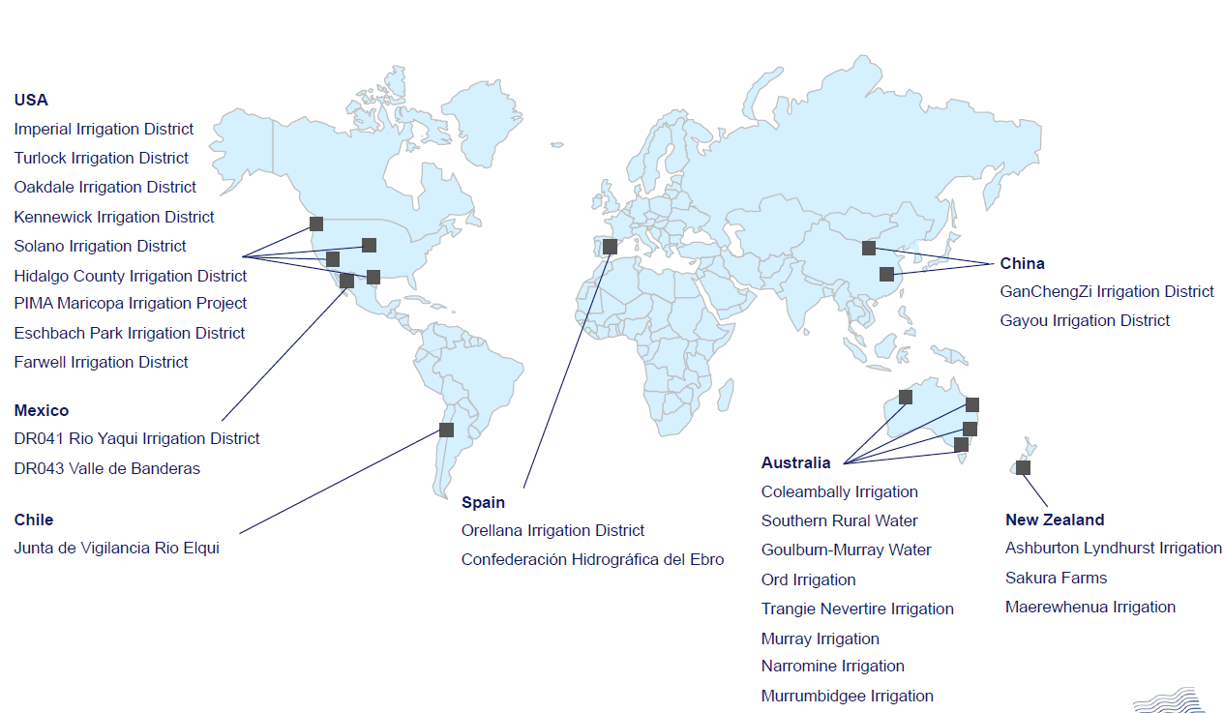
SlipMeter™ install base

Slide 10
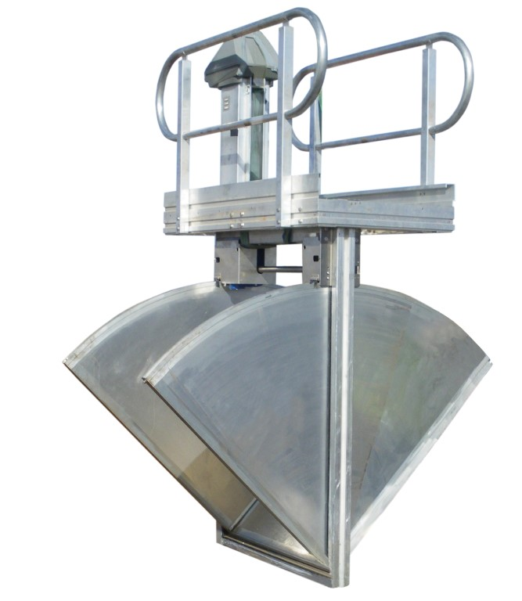

FlumeGate™
Overview
All in one Overshot gate and flow meter for farmer service points and Cross regulators
All in one means everything – drive system, motor control, ultrasonic measurement (water levels and flow), power supply, local control and telemetry
Robust high duty cycle operations and long life
SCADA ready
Autonomous control capability – Flow, USL, DSL and network control with a cascade of gates
Factory precalibrated and pre-commissioned. No in-situ calibration required
Easily installed and serviced
Comes in variety of standard sizes and custom options
Independently verified flow measurement accuracy of ±2.5% at National Metering Institute Certified Manly Hydraulics Lab
Flow measurement accuracy of ±2.5% has been independently verified under a wide range of conditions in the field in different countries
Meets ATS 4747 requirements
Exceeds SBx7 requirements
Patented/Patent pending across 18 jurisdictions including India

Slide 11
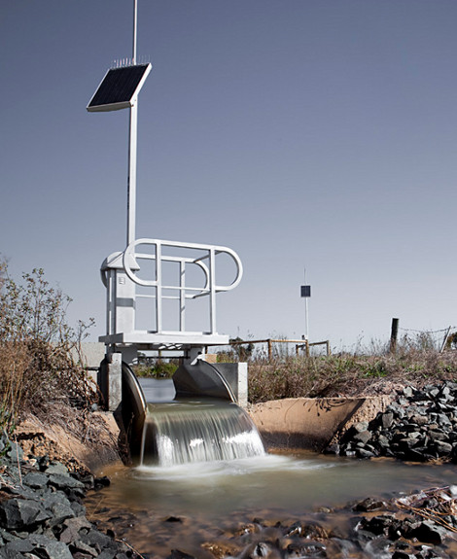
FlumeGate™
The FlumeGate™ is a precision flow meter with an accuracy of ±2.5%

Slide 12
The FlumeGate™s measurement accuracy has been independently assessed by the New South Wales Department of Commerce
Testing at the Manly Hydraulic Laboratory located in Manly, Sydney, NSW
Owned and Managed by NSW Department of Commerce
Used by the Australian Irrigation Industry to test a broad range of metering technologies
FlumeGate™ testing documented in Report MHL1427 August 2005

Slide 13
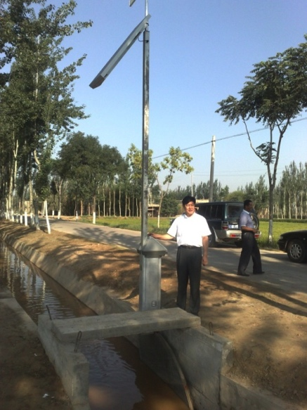
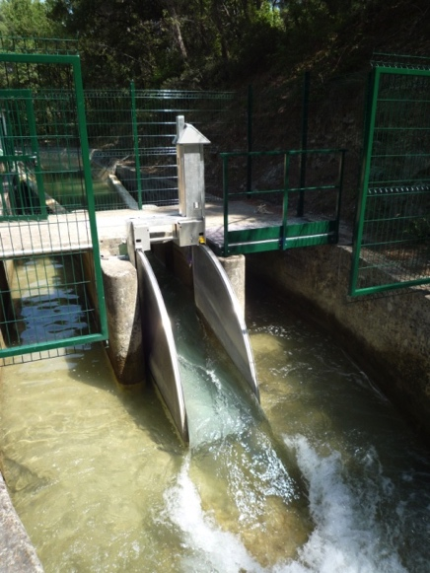
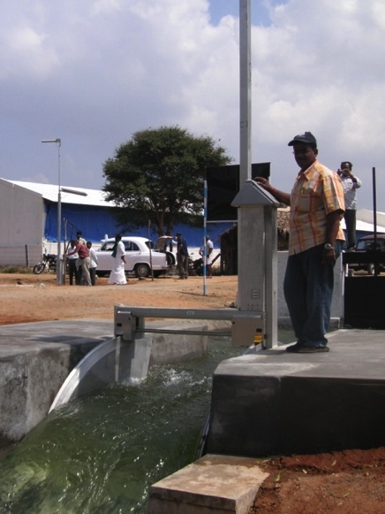
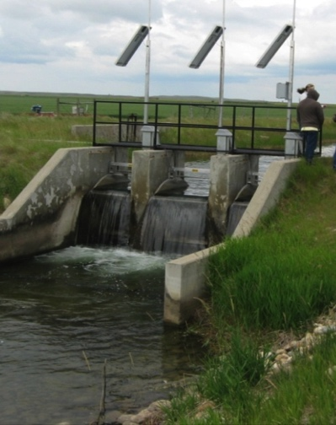
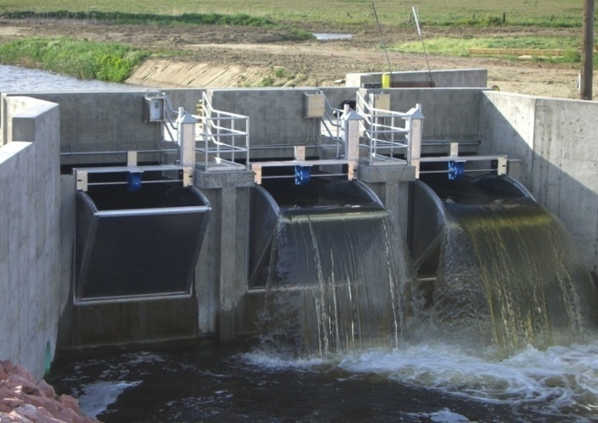
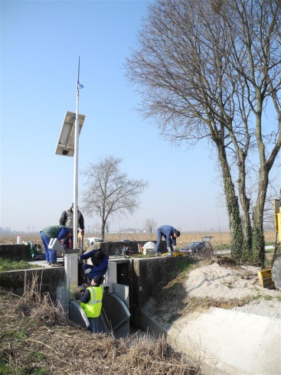
FlumeGate™
Application examples
China
France
India
Canada
USA
Italy

Slide 14
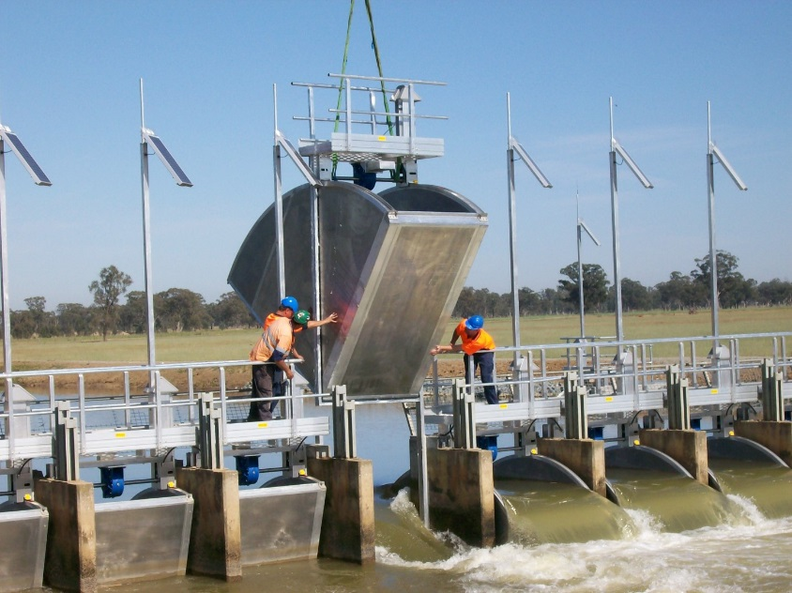
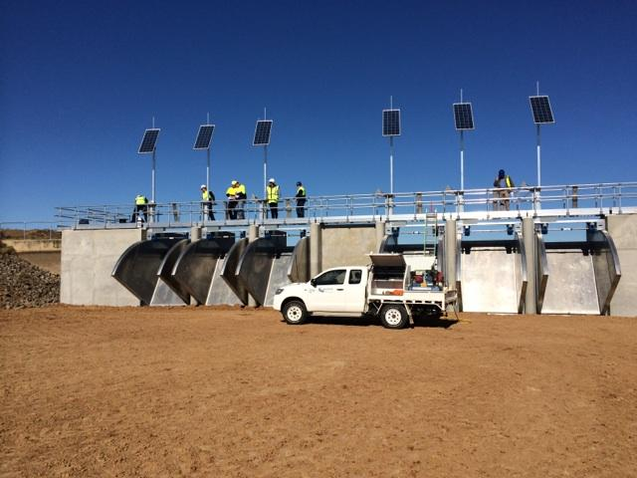
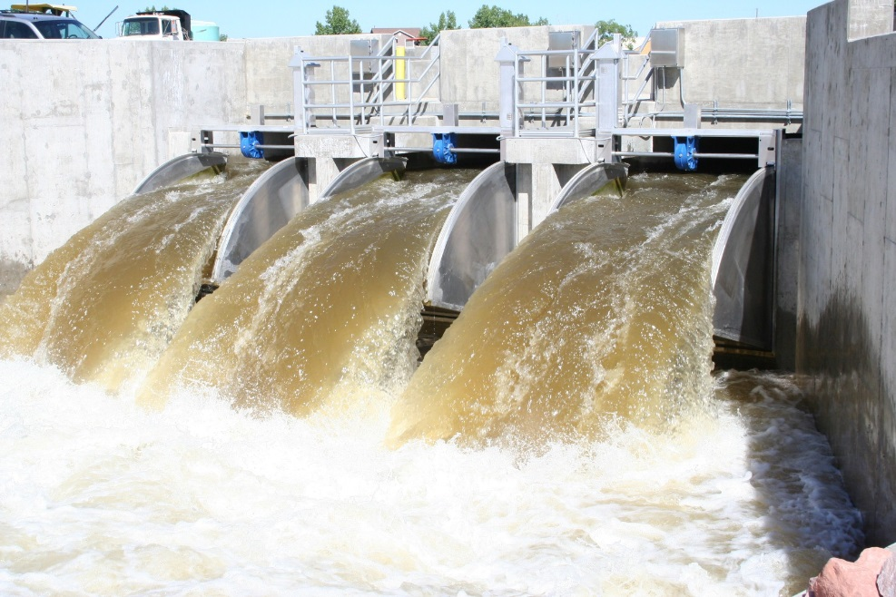
FlumeGate™
More application examples

Slide 15
FlumeGate™ customers
Number of customers by country
Australia: 17 | USA: 100 | China: 10 | Mexico: 5 | New Zealand: 5
Spain: 3 | Italy: 3 | France: 3 | India: 1
Chile: 1 | Vietnam: 1 | Sudan: 1 | Canada: 1

Slide 16
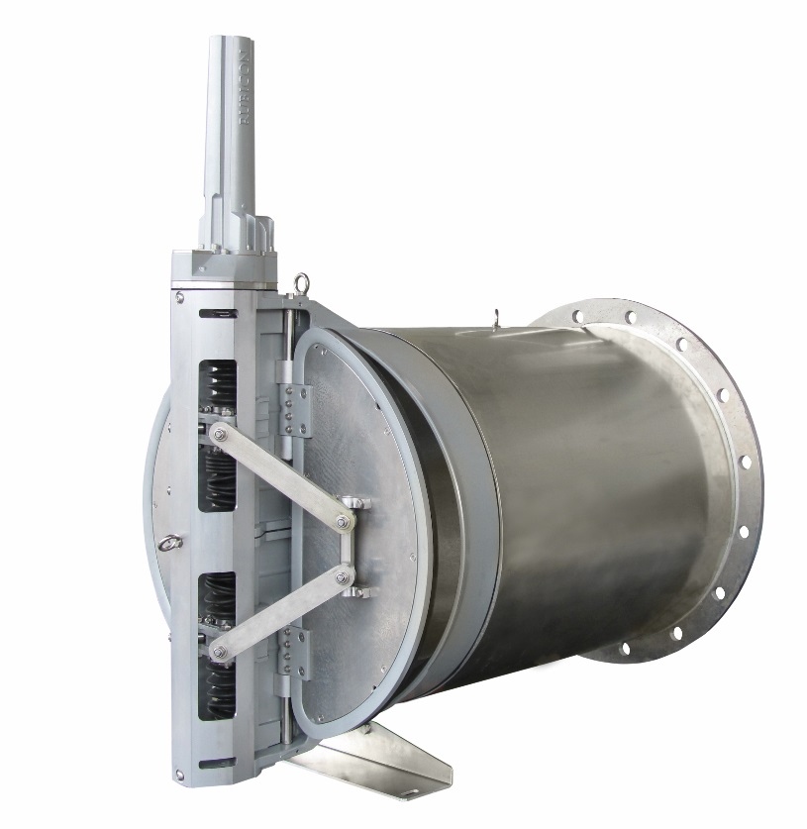
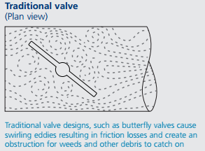
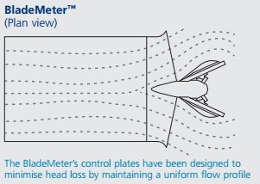
BladeMeter™
Overview
A recent major breakthrough in valve technology
Integrated valve and flow meter for farm service points on open canals and gravity/pressurised pipe systems
Dual plate design minimizes flow disturbance, head loss and provides symmetrical flow profile enabling integration of flow meter in the immediate vicinity

Slide 17
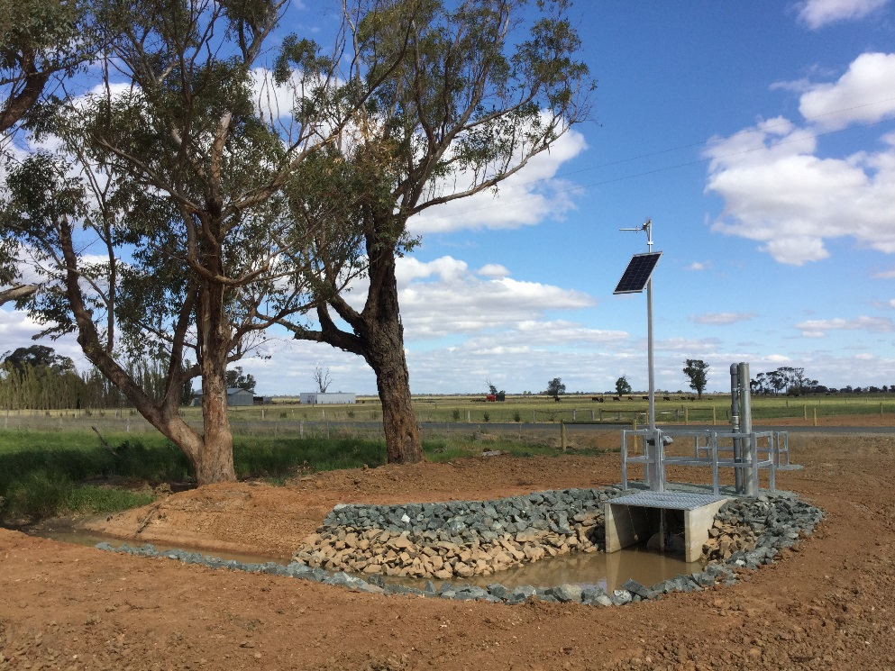
BladeMeter™
Overview
Solar powered
Fully submersible
Flow measurement accuracy of ±2.5%
SCADA ready
Robust high duty cycle operations and long life
Autonomous control capability – Flow, USL and DSL
Factory precalibrated and pre-commissioned
No in-situ calibration required
Easily installed and serviced
Comes in variety of standard sizes and custom options
Factory precalibrated. No in-situ calibration required
Easily installed and serviced
Comes in variety of standard and custom sizes
Flow measurement accuracy of ±2.5% verified at Rubicon hydraulics laboratory against calibrated ABB Magmaster. Currently undergoing independent tests at NMI accredited University of South Australia hydraulics laboratory
Meets ATS 4747 requirements
Exceeds SBx7 requirements
Patented/Patent pending across 18 jurisdictions including India

Slide 18
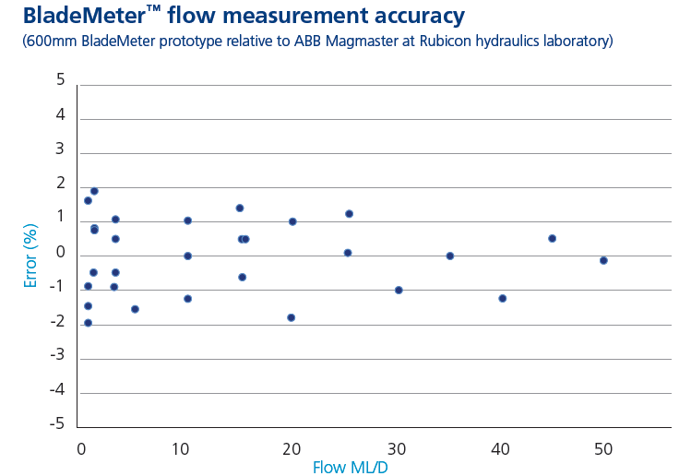
BladeMeter™ flow measurement accuracy

Slide 19
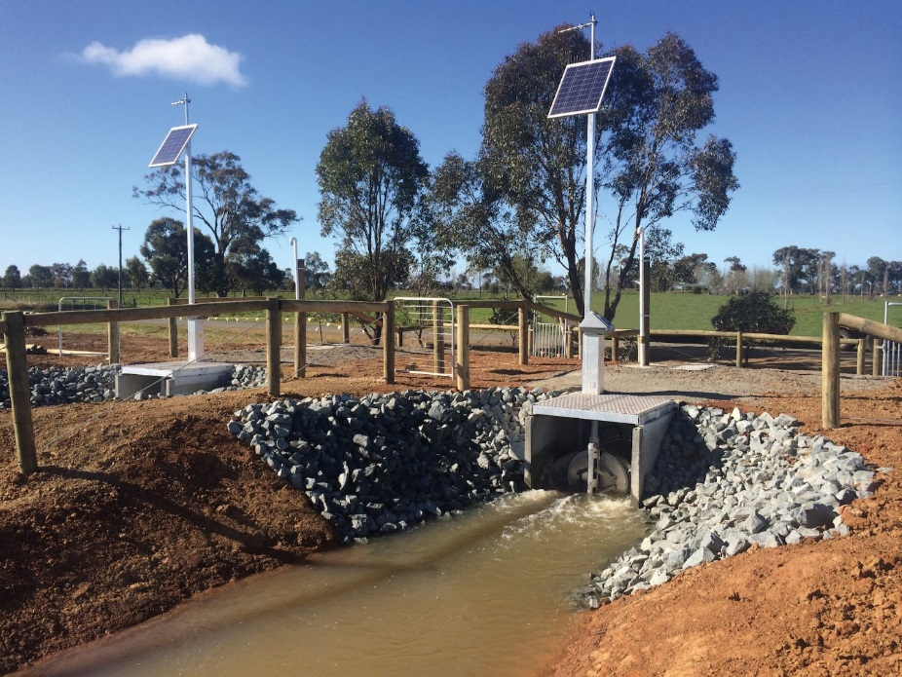
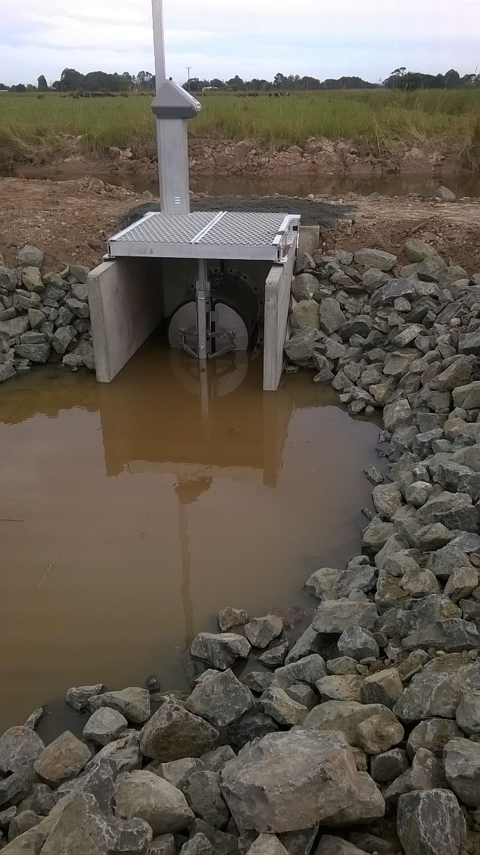
BladeMeter™ photos
BladeMeter farmer outlets on a hybrid pipe (gravity and pressurized on demand) network
BladeMeter farmer outlet on a open canal

Slide 20
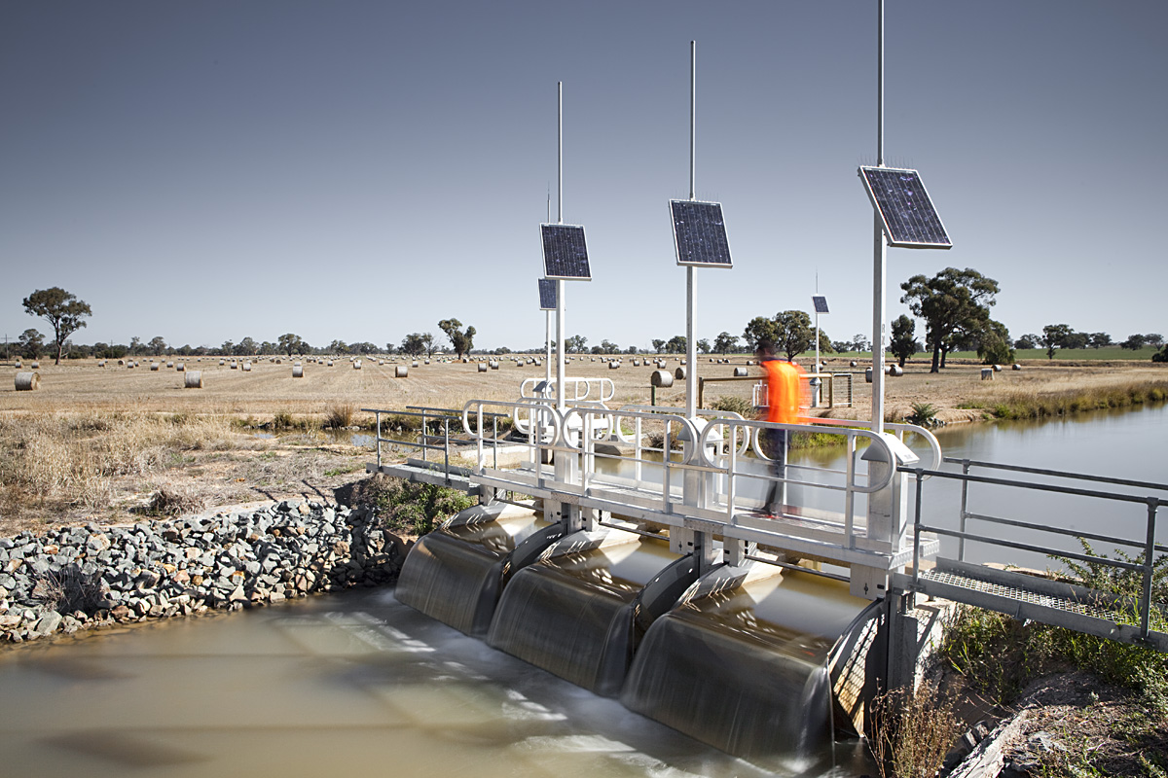
Metering generates powerful information.
Effective action on the information has to follow to improve efficiencies…

Slide 21

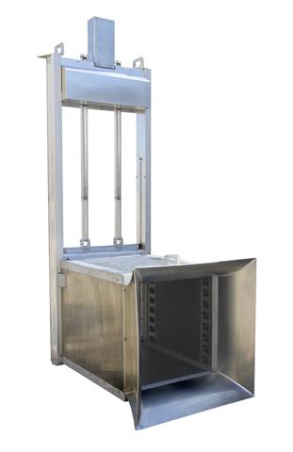
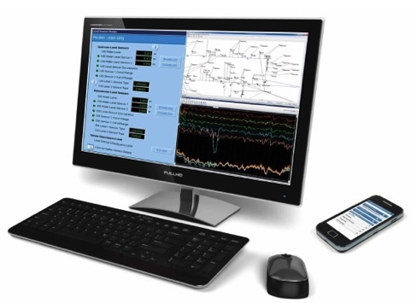
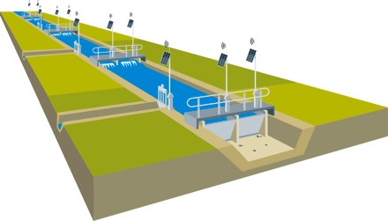
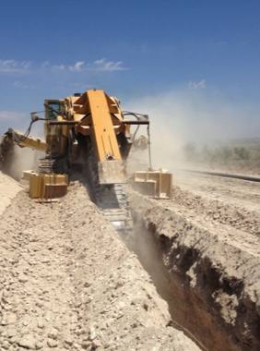
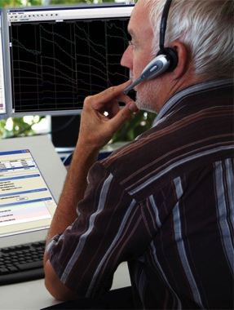
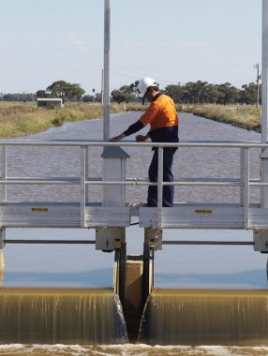


Rubicon Competencies
Control Gates
Meters
Network Control
Software
Construction
Operations
Maintenance
Research

Slide 22
Confidentiality
Copyright © 2016 Rubicon Systems Australia Pty Ltd ACN 069 232 284
All Rights Reserved.
No part of this document may be photocopied, reproduced, stored in a retrieval system, or transmitted, in any form or by any means whether, electronic, mechanical, or otherwise without the prior written permission of Rubicon Systems Australia Pty Ltd.
No warranty of accuracy is given concerning the contents of the information contained in this publication.
To the extent permitted by law no liability (including liability to any person by reason of negligence) will be accepted by Rubicon Systems Holdings Pty Ltd, its subsidiaries or employees for any direct or indirect loss or damage caused by omissions from or inaccuracies in this document.
Rubicon Systems Australia Pty Ltd reserves the right to change details in this publication without notice.
22

